Slide 1


Stacks and Queues in Programming
Real-World Analogies and Practical Applications
by Nisha K

Slide 2
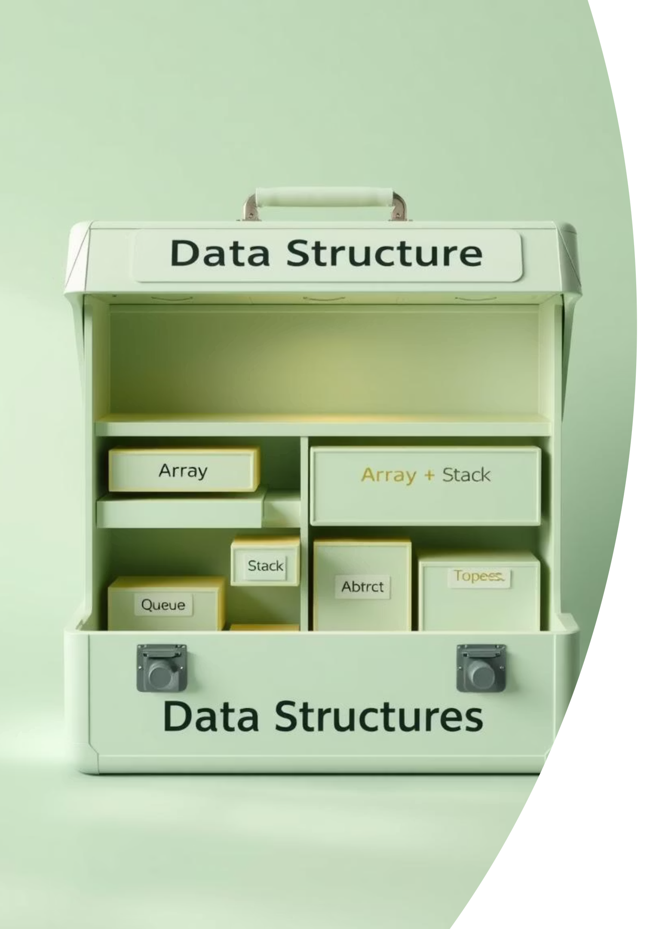




What Are Data Structures?
Organized Data
Ways of organizing and storing data for efficient use.
Linear Structures
Commonly used linear data structures include Stacks and Queues.
Stack (LIFO)
Last In, First Out principle.
Queue (FIFO)
First In, First Out principle.

Slide 3
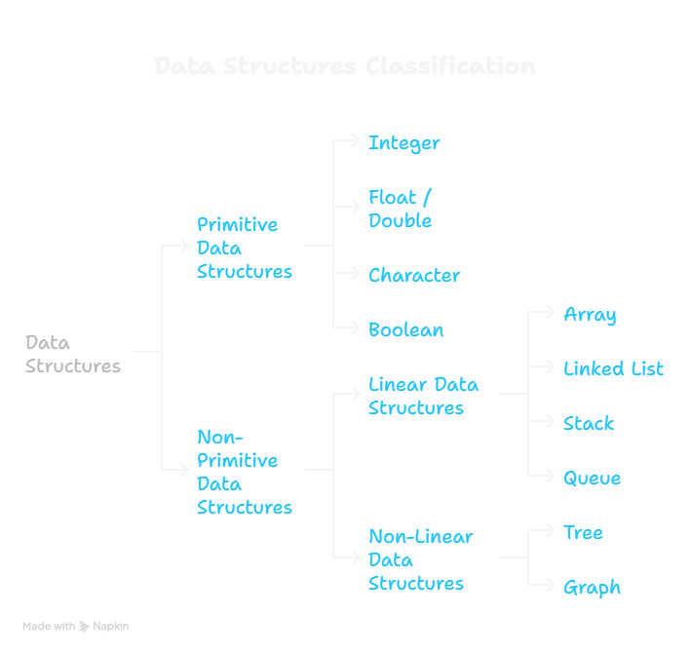

Slide 4
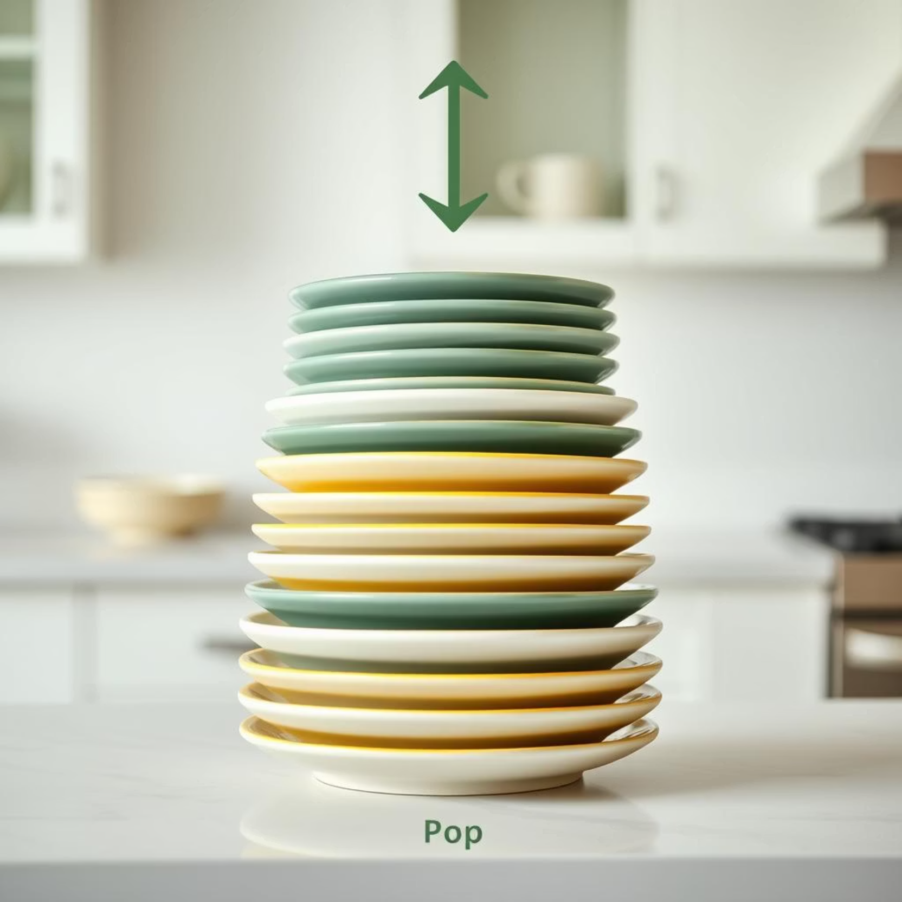
Understanding Stacks (LIFO)
The LIFO Principle
Imagine a stack of plates or books. You always add to the top and remove from the top.
The last item added is always the first one to be removed.
Real-World Example: Browser History
When you visit pages A → B → C, pressing "back" takes you from C → B → A, demonstrating LIFO.

Slide 5
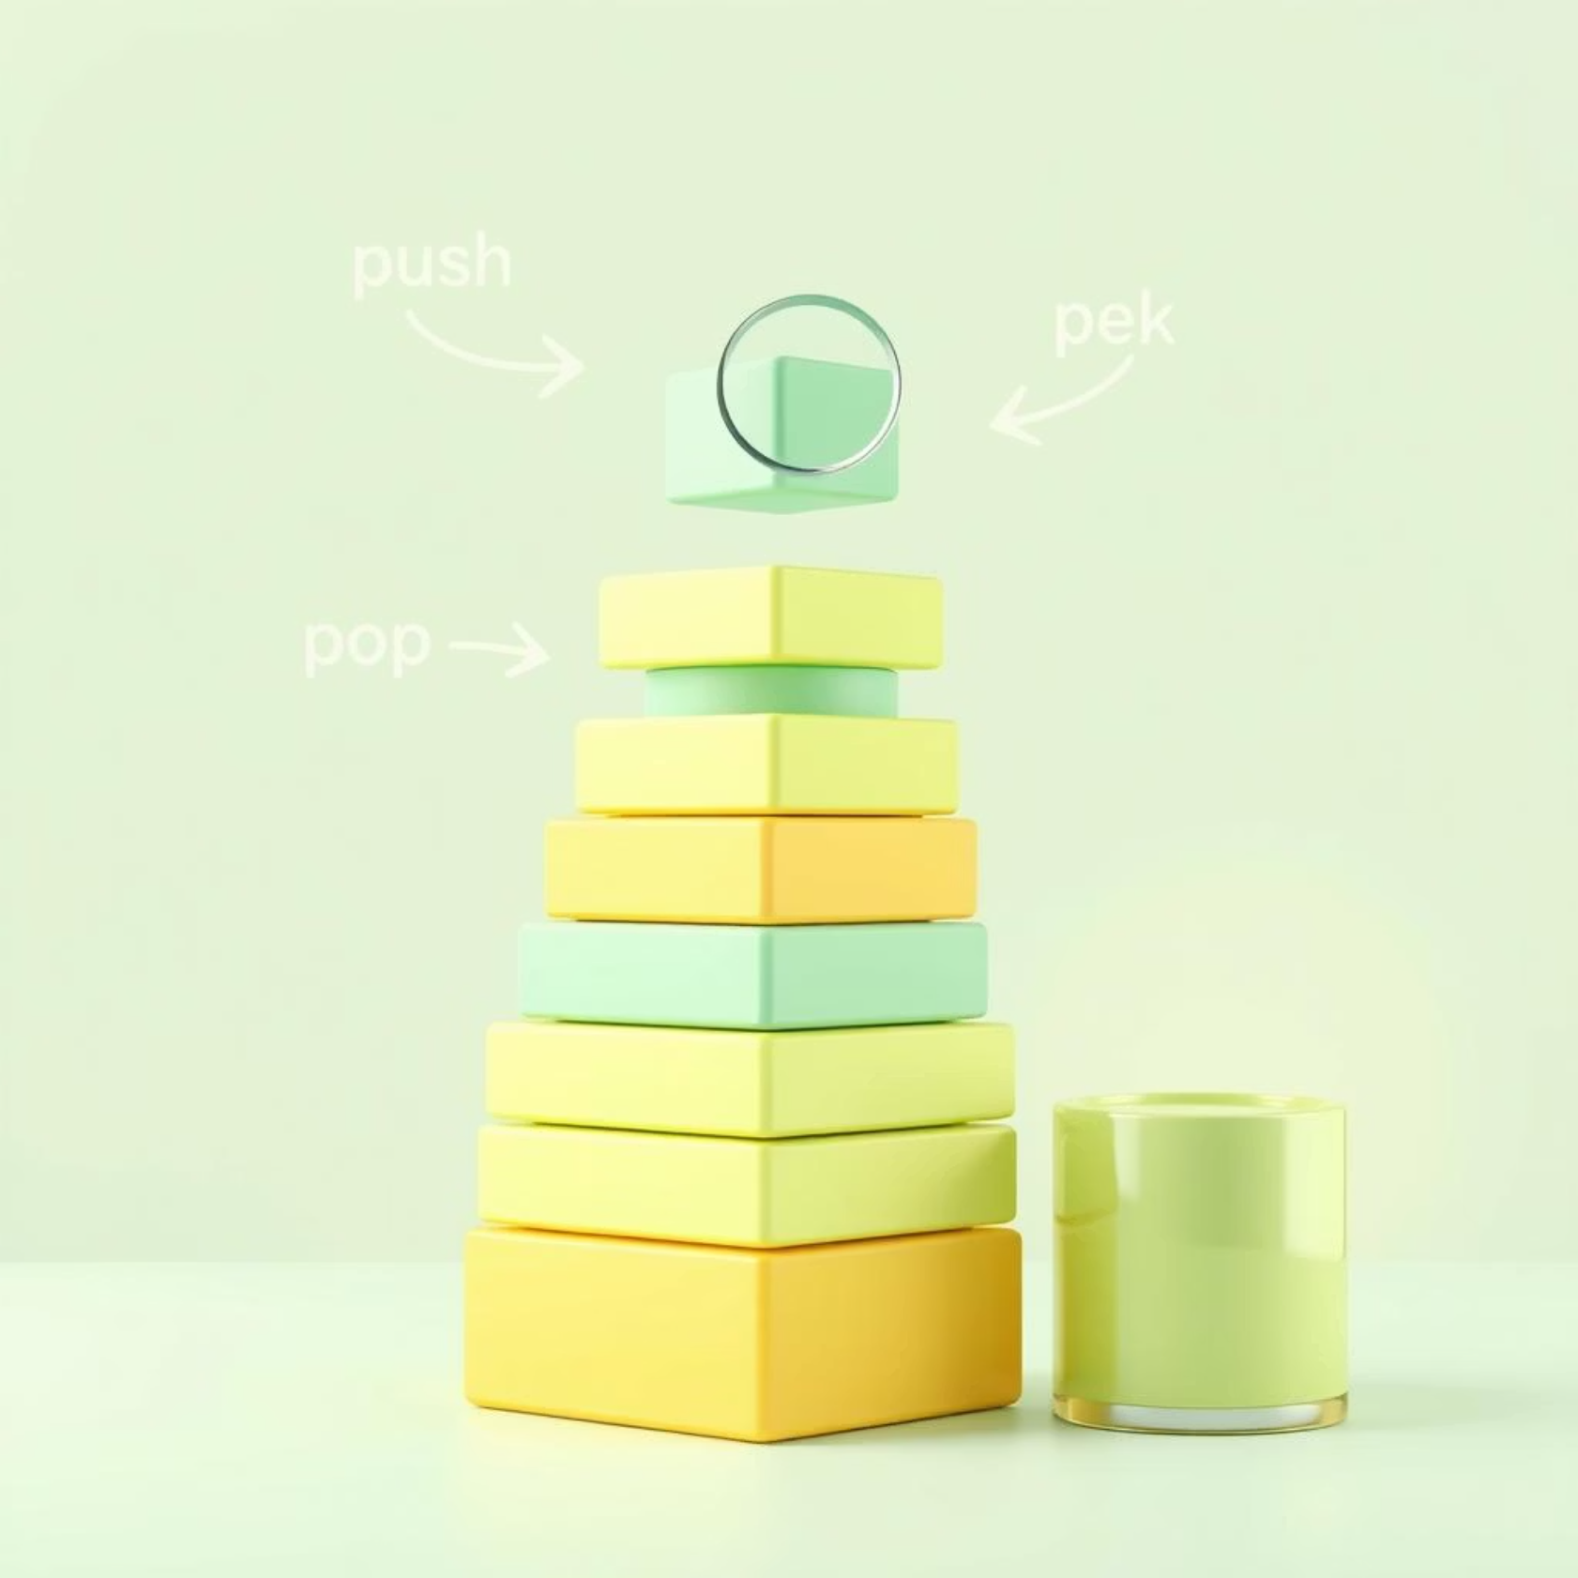
Stack Operations
Fundamental actions for managing data in a stack.
push(x)
Add element x to the top.
pop()
Remove the top element.
peek()
View top without removing.
isEmpty()
Check if the stack is empty.
Python Code Example:
stack = []stack.append('A') # pushstack.append('B')print(stack.pop()) # Output: 'B'

Slide 6


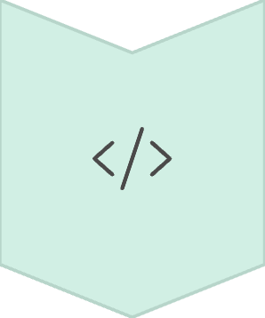


Stack Applications
Undo/Redo
Features in software like MS Word or Photoshop.
Function Call Stack
Manages nested function calls in programs.
Expression Evaluation
Used by compilers for arithmetic parsing.
Parking Garage
Single exit: last car in is the first out.

Slide 7

Understanding Queues (FIFO)
The FIFO Principle
Imagine people in a line at a ticket counter or for coffee. The first person in line is always the first to be served.
New items are added to the back, and removed from the front.
Real-World Example: Cafeteria Line
Trays are picked from the front, and new trays are added at the back, maintaining order.

Slide 8
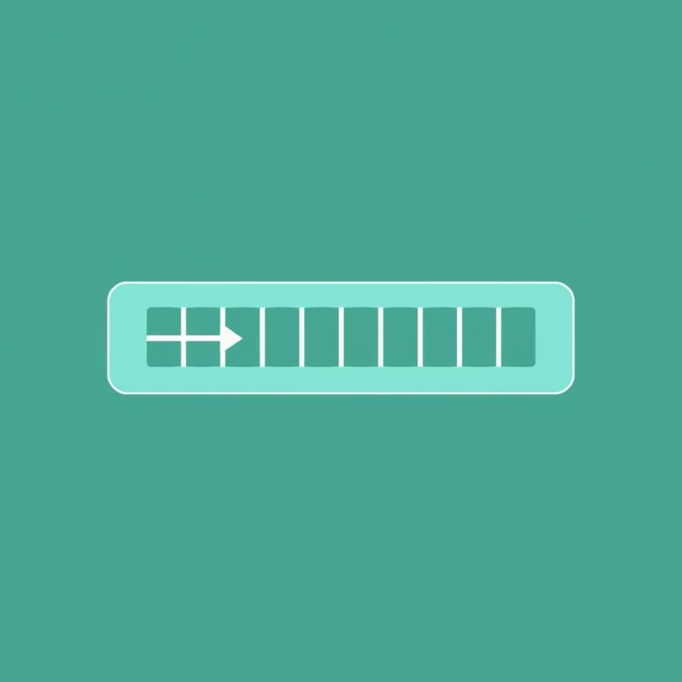
Queue Operations
Core operations for managing data flow in a queue.
enqueue(x)
Add element x to the rear.
dequeue()
Remove element from the front.
peek()
View front without removing.
isEmpty()
Check if the queue is empty.
Python Code Example:
from collections import dequequeue = deque()queue.append('Task1') # enqueuequeue.append('Task2')print(queue.popleft()) # Output: 'Task1'

Slide 9





Queue Applications
Print Spooler
Customer Support
Handles print tasks in order of arrival.
Serves oldest support tickets first.
CPU Scheduling
Traffic Signals
Manages tasks on a first-come, first-served basis.
Regulates cars passing in order of arrival.

Slide 10
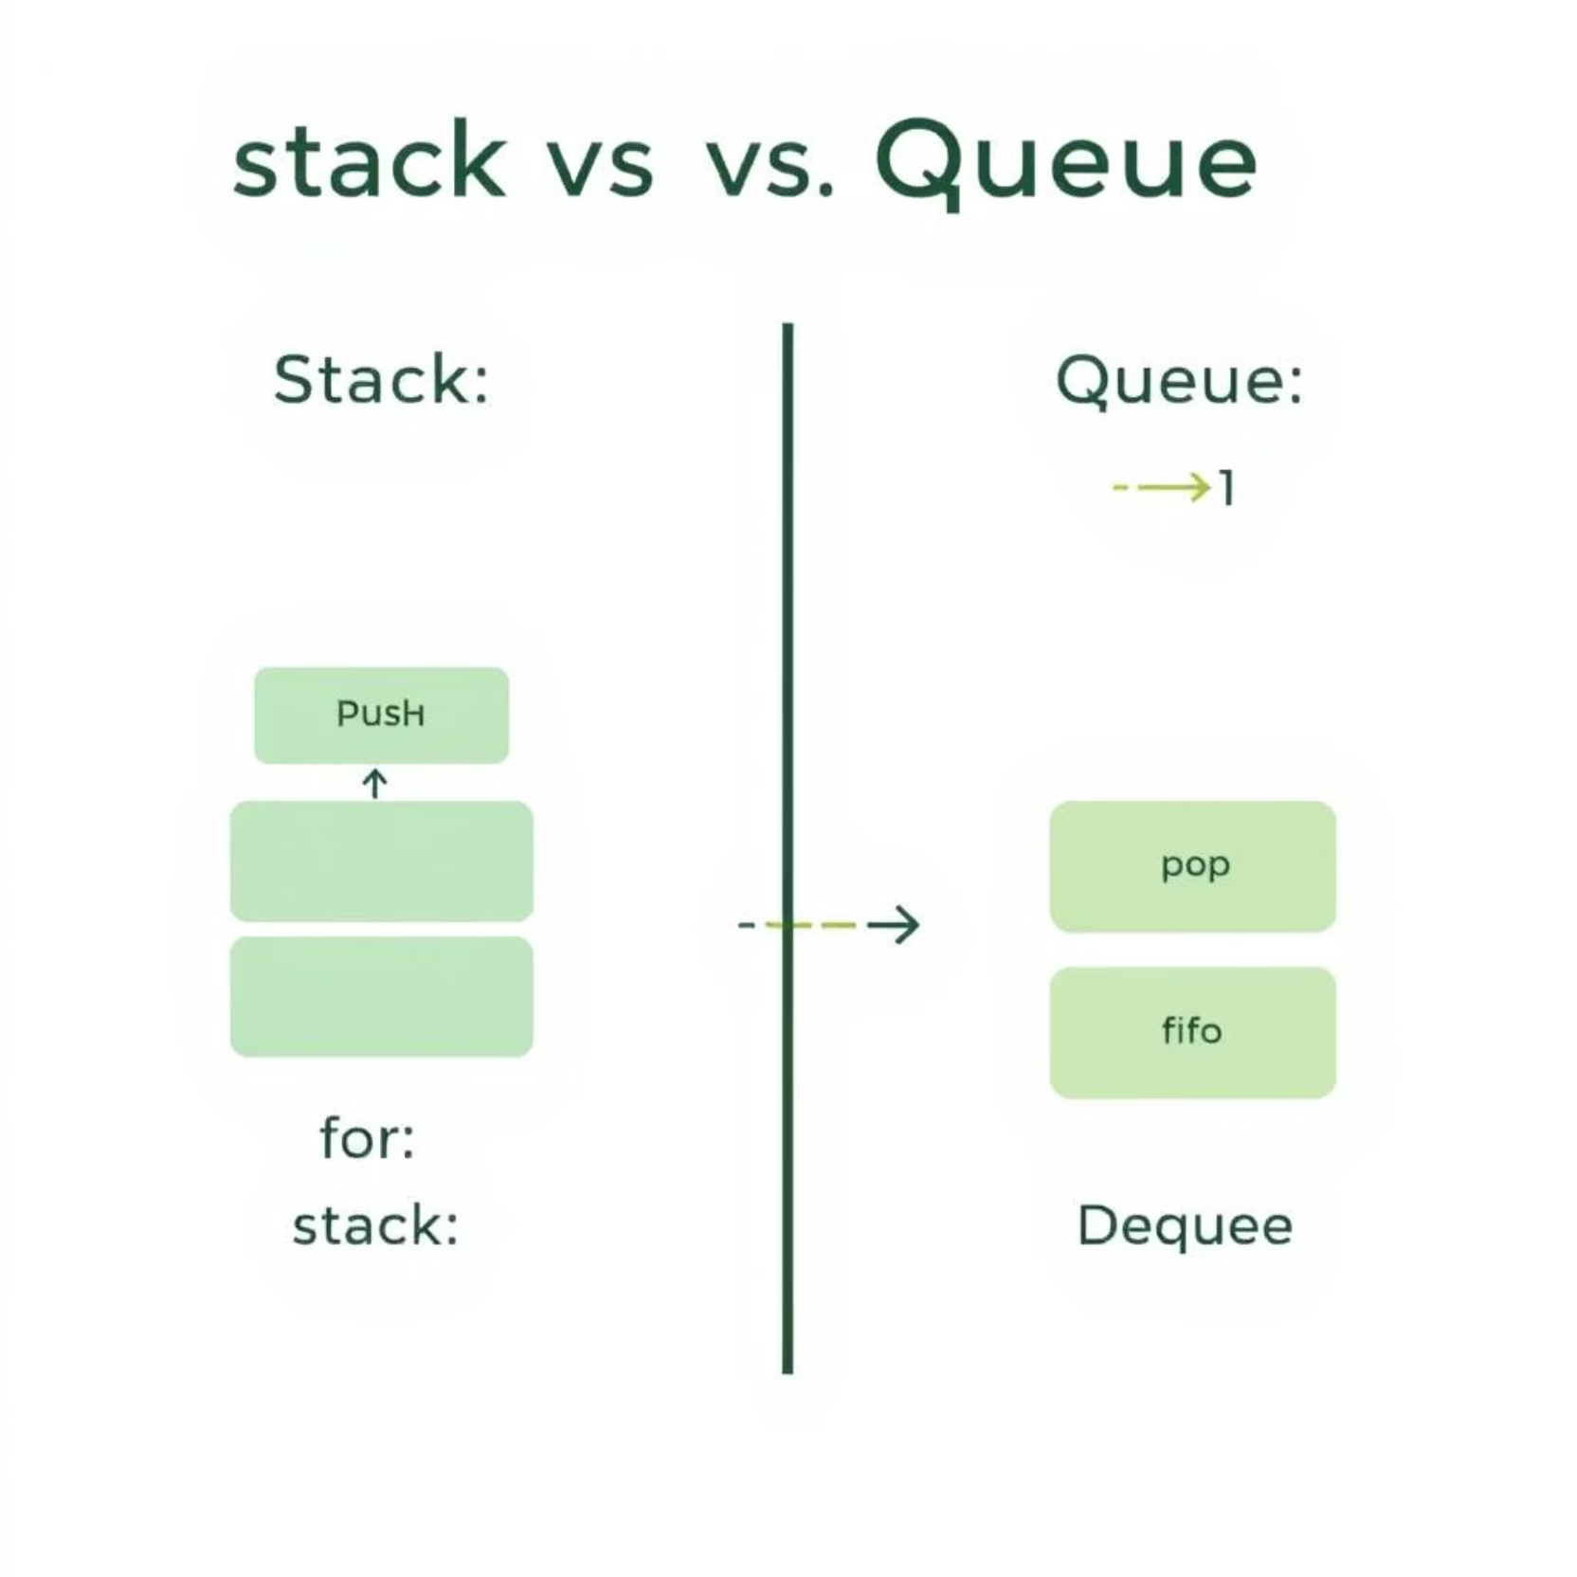
Visual Comparison: Stack vs Queue
Key differences in behavior and access.
Order
Last In → First Out
First In → First Out
Analogy
Plate Dispenser
People in Line
Main Use
Backtracking, Undo
Scheduling, Buffers
Access Point
One end (Top only)
Both ends (Front/Rear)

Slide 11
Implementation Basics
Stack Implementation
Efficiency
Use arrays or lists (e.g., Python list).
Keep track of the top pointer.
Choose the right data structure for optimal performance in your programs.
Queue Implementation
Problem Solving
Use list + front index.
Better: deque from collections module.
Understanding these structures is key to solving complex programming problems.
Next Steps
Practice implementing both stacks and queues in your preferred language!

Slide 12
When to Use What? Practical Scenarios
Back/Undo Functionality
✅
❌
Print Job Scheduling
❌
✅
Recursion (Function Calls)
✅
❌
Service Order (Ticket System)
❌
✅

Slide 13


Real-World Analogies and Key Principles
Stack: LIFO (Last-In, First-Out)
Queue: FIFO (First-In, First-Out)
Plates in a stack
People in line at a bank
Browser history (Back button)
Printer job queue
Parking garage with one entrance/exit
Call center queue
Undo/Redo functionality in software
Bus stop waiting line

Slide 14

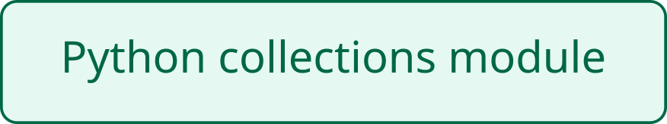
Summary & Resources
Stack = LIFO
Ideal for backtracking, undo operations, and nested function calls.
Queue = FIFO
Perfect for scheduling tasks and managing real-time services.
Essential Tools
Both are fundamental for writing efficient and organized code.
Thank you for your attention! Any questions?

Slide 15
GOOGLE COLLAB NOTEBOOK LINK
https://colab.research.google.com/drive/1tT0yUvHfNb-UUR_hv77M7FA0C-3aiHVi?usp=sharing

